Slide 1
Decentralized Government Let’s create America’s Blockchain Framework
A trustless solution for exchanging data In the United States of America.

Slide 2
The problem: Centralization of power and centralized identity systems.
With the advent of technology governments are becoming less transparent, less efficiency. and more controlling.

Slide 3
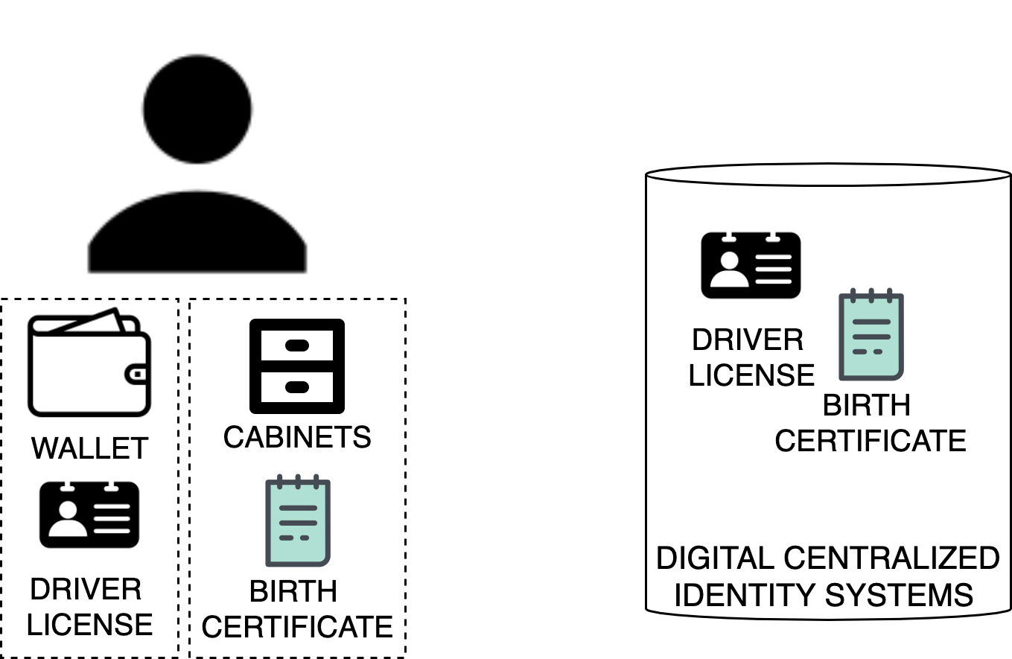
How we currently manage identities and credentials.
In the physical world, we use the physical credentials in our wallet to prove our identity.
The physical credentials are issued by centralized authorities.

Slide 4
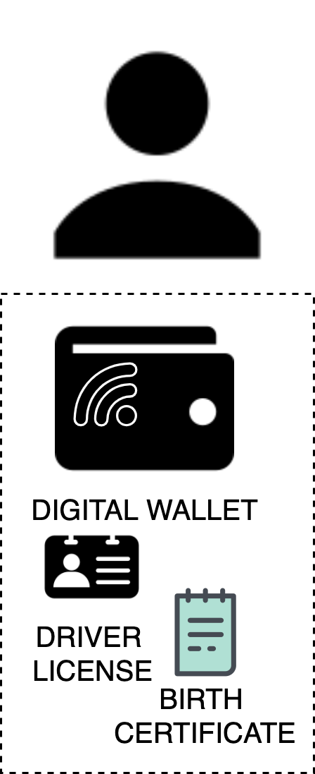
The solution
Digital self sovereign identity infrastructure that allows people, companies and governments to interact with one another in a decentralized manner.

Slide 5
The products
Easy-to-use platform that creates, issues and manages verified credentials by different government entities.
Consumer facing mobile wallet application to interact with the different credentials.

Slide 6
How to make money
Charge third party company fees to access public data in efficient ways.
Ex: The title insurance business pays to access public records of property and taxes via title plants. We can replace them with a public records blockchains.
Build enterprise software to integrate with the public blockchains.
Build PaaS(no code) that allows for companies to integrate seamlessly with the different blockchains.

Slide 7
Industries to be disrupted
Electronic signature ($70B)
Title insurance ($26B)
Document management ($7B)

Slide 8


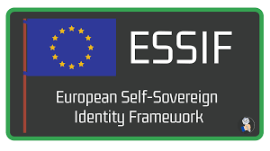

Current initiatives worth mentioning.
Open Source Identity Blockchain¹.
The world’s leading platform for verifiable credentials².
Open source SDK for implementing identity blockchains³.
Government that has a digital services for 1.3M people⁶.
British Columbia created a searchable directory of public, verifiable data issued by government authorities about businesses⁵.
Legislation that describes how to offer cross-country public services⁴.
1 https://sovrin.org/
2 https://www.evernym.com/
3 https://github.com/hyperledger/indy-node#about-indy-node
4 https://ec.europa.eu/cefdigital/wiki/pages/viewpage.action?pageId=262505734
5 https://orgbook.gov.bc.ca/en/home
6 https://e-estonia.com/solutions/

Slide 9
Why Now?
The W3C DID working group finalized the DIDs V1.0 specification². (Aug 2021)
DHS is funding DIDs as replacements for social security identifiers¹. (Aug 2020)
3rd Generation blockchains³ are getting critical mass. (Sept 2018)
Decentralized Public Key Infrastructure⁴. (Dec 2015)
1 https://www.dhs.gov/sites/default/files/publications/ssn_fraud_prevention_act_report_2020_final_08-21-2020_0.pdf
2 https://w3c-ccg.github.io/did-wg-charter/
3 https://eprint.iacr.org/2018/378.pdf
4 https://danubetech.com/download/dpki.pdf

Slide 10
Why?
People can own their data which is ensured by cryptography and not by legal a contract.
There is less opportunity for government corruptions and malpractices.
Enable decentralized commerce and interactions in the US as third parties cannot be trusted.

Slide 11
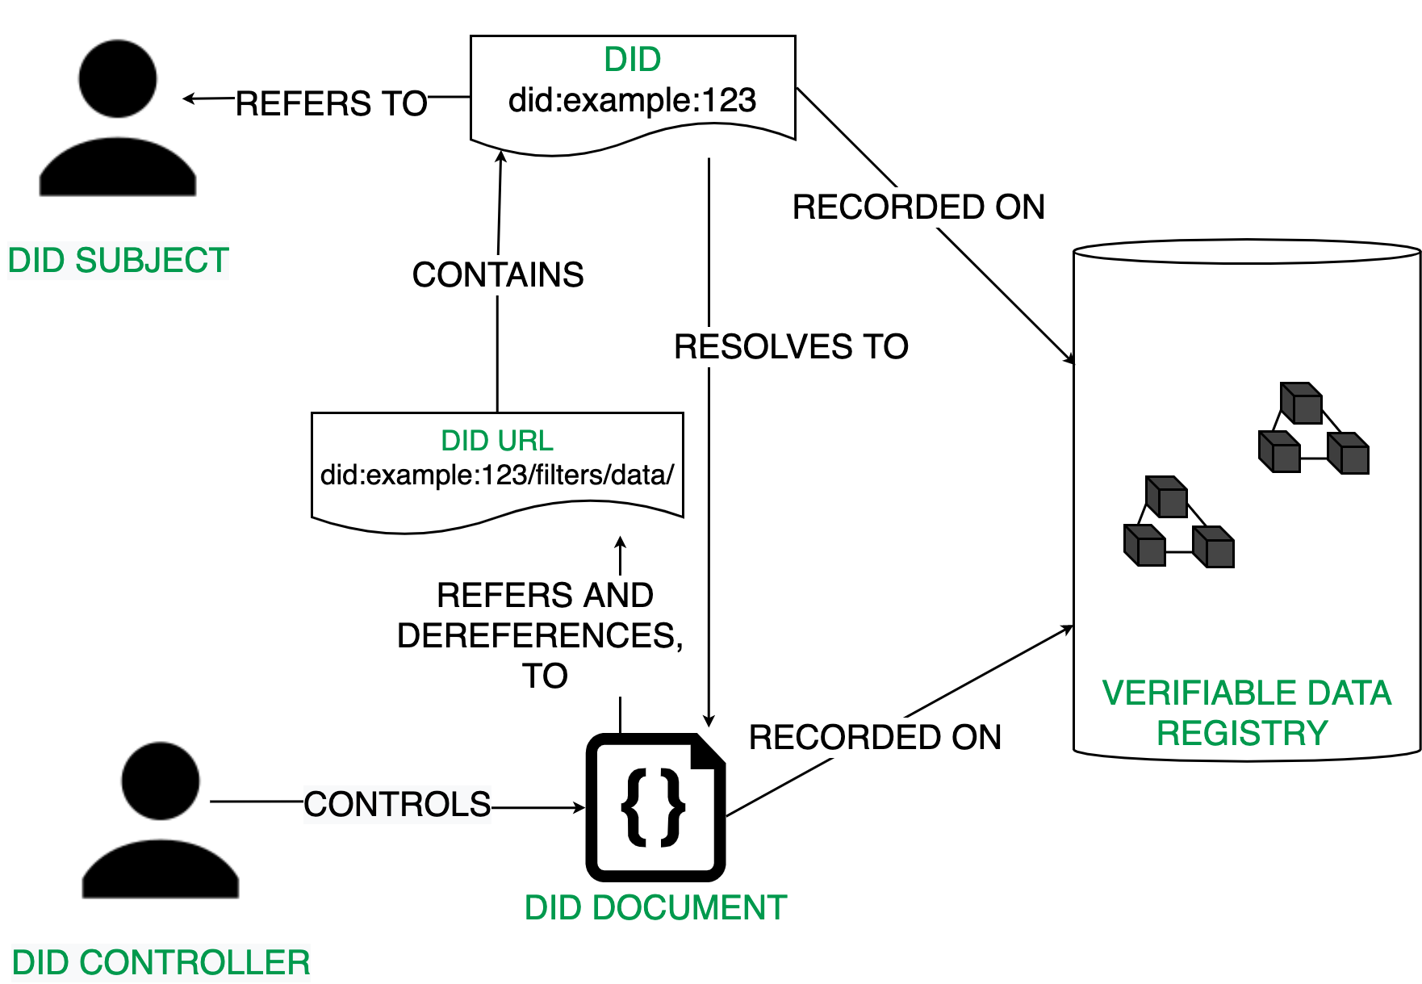
Technical Competitive Edges
Decentralized Identifiers are a new type of identifier that enables verifiable, decentralized digital identity.
https://www.w3.org/standards/history/did-core

Slide 12
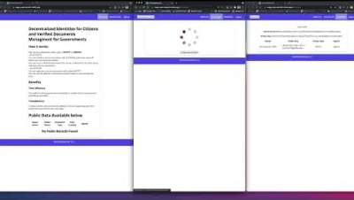
DEMO - DMV USE CASE
https://www.youtube.com/watch?v=tS9bXd7Bc7I&ab_channel=AlexAndrei

Slide 13
TEAM

